Slide 1

CHURN PREDICTION

Slide 2
AGENDA
INTRODUCTION
OBJECTIVE
PROBLEM STATEMENT
PROCESS OVERVIEW
RESULTS
CONCULSION

Slide 3

INTRODUCTION

Slide 4
Objective
Business Objective:
Customer retention
Cross-sell/Up-sell (secondary)
Analytics Objective:
Prediction of propensity to churn from the usage behavior

Slide 5
Problem Statement
What is the problem?
Why does the problem need to be solved?
How would i solve the problem?

Slide 6
Types of churn
Involuntary
Internal
Voluntary
Need to Focus

Slide 7
Reasons for churn
Inadequate services.
Quality of services.
Plenty of attractive offers.
Customer dissatisfaction.

Slide 8
Input Variables
Usage data:
Voice usage
Data usage
Subscriber data
Customer type
AON (Age on Network)
Disconnection type, etc
Payments data:
Monthly payment data

Slide 9
Data Transformation
Data collection
Data identification
Validation & Cleaning
Addition of derived variables
Preparation of model set
Conduct modelling

Slide 10
Process
Merging the data files
All the three files are merged into a single file for very month.
Removing duplicate id’s
Deriving new variables from the existing variables.
Checking the outliers
Function has been written to check for the outliers and remove it.

Slide 11
Replacing the NA values
The numeric NA values has been replaced with median.
Changing the date format
The format of the date was not proper so the format of the date is changed.

Slide 12
Model Generation
Logistic regression is applied on the training data set.
Model Evaluation
For model evaluation Roc curve and confusion matrix is used.

Slide 13
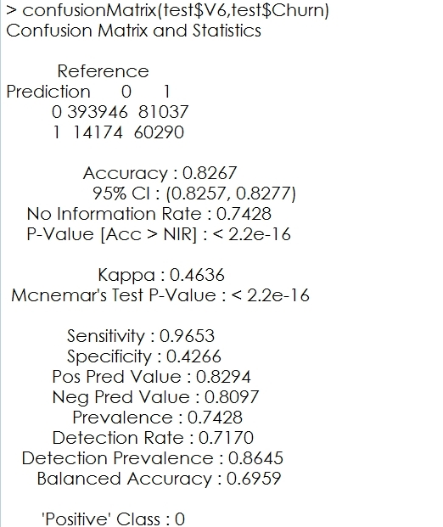
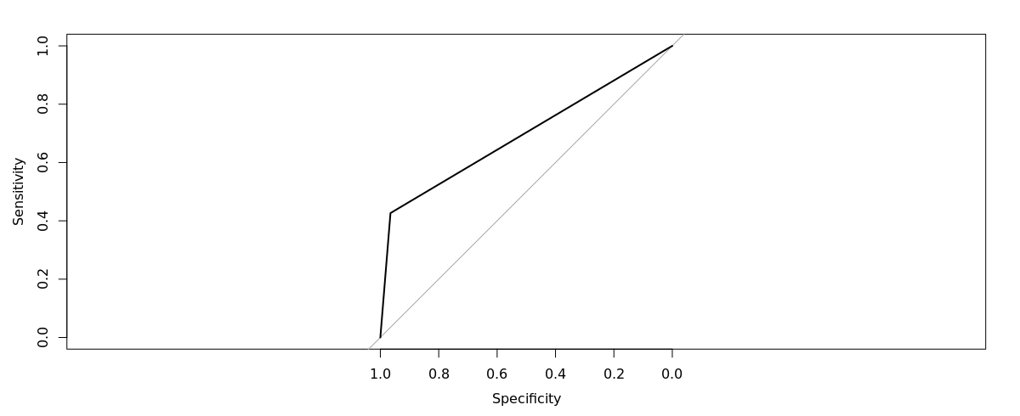
RESULT

Slide 14
Conclusion
By training the model and applying it to the test dataset the model predicts if the customer will churn or not.
According to prediction result the service provider can take a action on that customer.

Slide 15
THANK YOU!!!

